Slide 1
Artificial Intelligence in Brain Implants and Brain-Computer Interface Technology
Notes:
I worked on brain implant technologies and applications

Slide 2
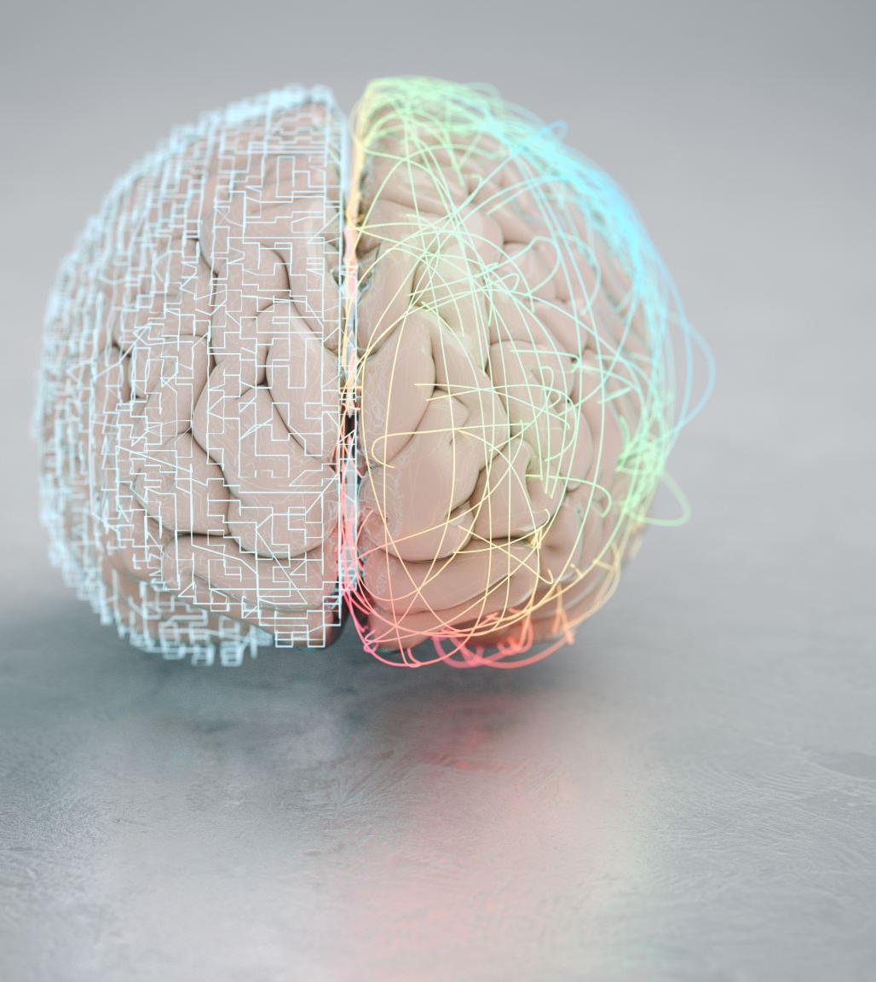
Outline:
Introduction
Brain Implant Technologies
Electro encephalography (EEG) based BCIs
Intracortical microelectrode arrays
Optogenetics
Magneto encephalography (MEG) based BCIs
Applications of Brain Implants
Conclusion
Notes:
I am sharing some fundamental details regarding brain implant technologies and heir various applications
this is outline of my research paper

Slide 3
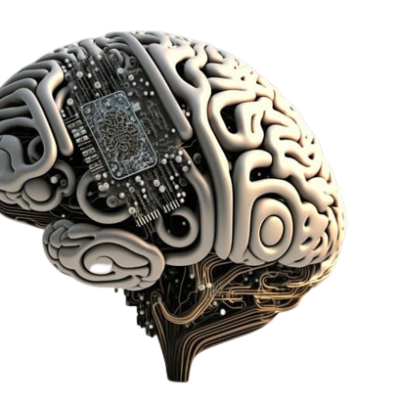
Introduction:
Brain-computer interfaces (BCIs) allow communication between the brain and an external computer or machine, aiding individuals with severe disabilities. This paper provides an overview of brain implant technology, applications. Brain implants are a type of BCI that involve electrodes directly inserted into the brain, used for treating neurological conditions, enhancing cognitive abilities, and other purposes. The paper discusses the history of brain implant technology, different types of implants, their applications in medicine and research, ethical considerations, and the current state of the field with future directions.
Notes:
Brain Computer interfaces (BCI's) allows communication between brain and external computers or machines aiding individuals with severe disabilities.
paper overview : Brain implants, BCI types , history and future

Slide 4
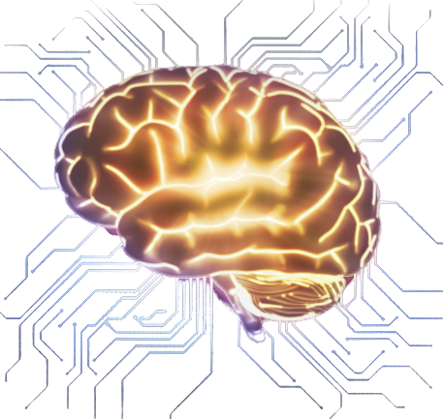
Brain Implant Technologies:
Electro encephalography (EEG) based BCIs
Intracortical microelectrode arrays
Optogenetics
Magneto encephalography (MEG) based BCIs
Notes:
There are four technologies

Slide 5
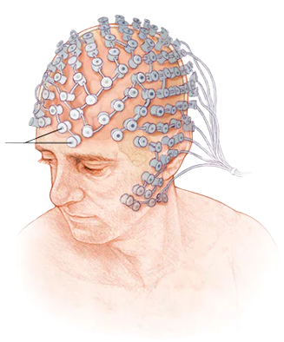
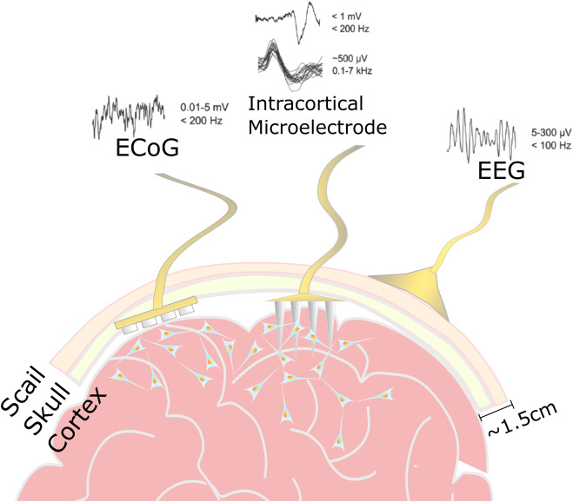
Electro encephalography (EEG) based BCIs
Intracortical microelectrode arrays
monitoring brain activity that records electrical signals from the scalp using ‘Electrodes’.
surgically implanted into the brain to record or stimulate neural activity.
Electrodes in direct contact with neurons
Electrodes detect neuron activity, enabling cellular level brain investigation
Intracortical microelectrodes have prosthetic and interface potential but carry risks and long-term stability challenges.
Electrodes detect brain changes and control devices using thoughts.
EEG-based BCIs offer potential in medicine, gaming, and communication. Safe, painless, high-temporal resolution, and innovative.
Notes:
EEG :
1. Monitor brain activity that records electrical signals from scalp using electrodes
2.here electrode detects brain changes and control devices using thoughts
3.This devices potential in medicine, gaming and communication
4.these are safe , pain less , high temporal resolutions and innovative
Intracortical:
1.microelectrodes implanted surgically into brains to record or stimulate neural activity
2.here electrodes in direct contact with neurons.
3.electrodes detects neuron activity , enabling cellular level brain investigation
4. carry risks and long - term stability challenges are obtained

Slide 6
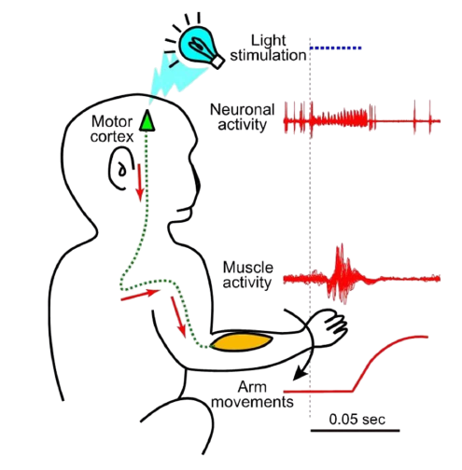
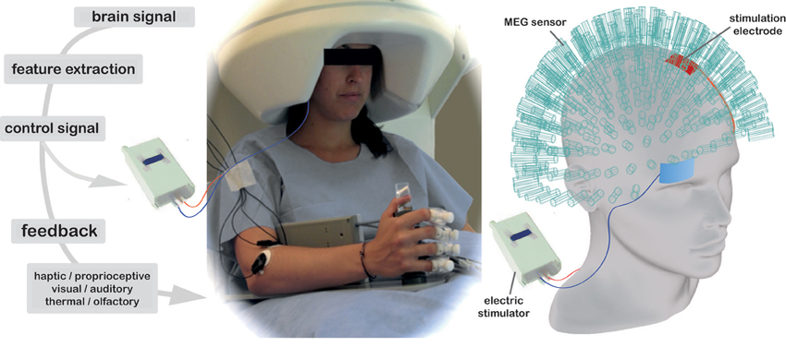
Optogenetics
Uses light-sensitive proteins to control brain neuron activity.
Genetically modified neurons express proteins, controlled by light manipulation.
Optogenetics revolutionizes neural circuit study by identifying specific behavior-disease circuits.
Optogenetics potential in treating neurological/psychiatric disorders and BCI. Challenges include safe/proper light delivery and protein expression specificity.
Magneto encephalography (MEG)
MEG-based BCIs measure magnetic fields generated by brain activity non-invasively with high resolution.
They offer precise device control but are complex and costly, with promise for advancing assistive technologies and brain understanding.
Notes:
optogenetics:
1. we use light to control brain neuron activity
2. here genetically modified neurons with light manipulation
3.revolutionizes neural circuit study and identify specific behavior diseases circuits.
4.this method is potential in treating neurological disorder and BCI
5.challenges to deliver and protein expression specificity
MEG
1.mesures magnetic field generated by brain with high resolution
2.this offers precise device control , but are complex and costly
3. used for advancing assistive technologies and brain understanding

Slide 7
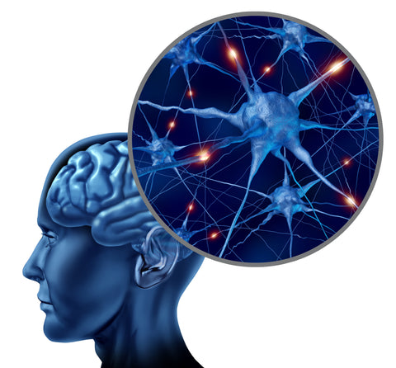
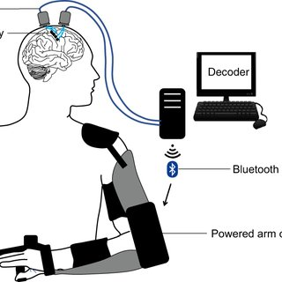
Applications of Brain Implants:
Therapeutic applications: focus on treating neurological disorders, such as Parkinson's and epilepsy, by modulating neural activity
Assistive technologies: help restore lost functions, like cochlear implants for hearing or retinal prosthetics for vision, enabling individuals to lead independent lives.
Cognitive enhancement: a more controversial area, aims to augment human intelligence, memory, and creativity, potentially revolutionizing education and workforce productivity.
Overall, brain implants hold significant potential for transforming human lives, from mitigating disabilities to expanding cognitive capabilities.
Assistive technologies:
Cognitive enhancement:
Enables individuals with paralysis or limb amputation to control external devices
Prosthetic limbs, communication interfaces
Augments human cognition, memory, and learning capabilities
Raises numerous ethical concerns
Notes:
Assistive technologies
also for partial vission for blind

Slide 8

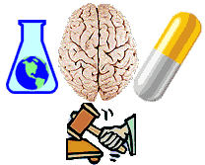


Ethical Considerations:
Neuro ethics:
Establishes clear ethical guidelines and regulations
Mitigates potential negative consequences
Promotes responsible advancement
Informed consent:
Critical due to invasive nature and potential risks
Ensures patients understand and agree to the procedure
Access and equity:
Ensures equitable access to brain implant technologies
Addresses socioeconomic and geographical disparities
Privacy and data security:
Protects sensitive brain data
Requires robust measures to prevent unauthorized access and misuse

Slide 9
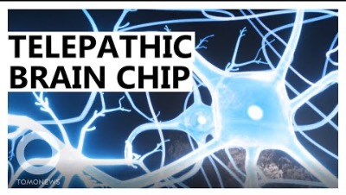
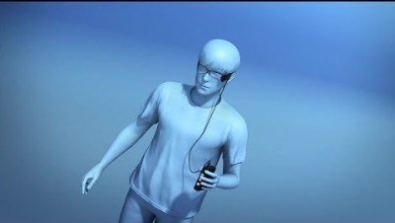

Conclusion:
Brain implants hold immense promise in treating neurological disorders, developing assistive technologies, and enhancing cognitive capabilities.
Resources:
Brain- Implant Devices brain to computers
Partial Vision To the Blind
Monkey playing video game with brain
References:
Neuralink: Elon Musk unveils pig with chip in its brain. (2020, August 28). BBC News. Retrieved from https://www.bbc.com/news/technology-53930775.
https://en.wikipedia.org/wiki/Neuralink
https://www.nbcnews.com/mach/science/memory-boosting-brain-implants-are-works-would-you-get-one-ncna868476

Slide 10

Thank You

